Slide 1
Auditing source code for vulnerabilities
November 2018

Slide 2
01 Introduction
02 Theory
03 Vulnerabilities
04 Audit
05 Workshop audit
06 Conclusion

Slide 3
01
Introduction

Slide 4
To introduce skills and knowledge required to identify vulnerabilities in source code

Slide 5

`whoami`
Eldar Marcussen
Lead security researcher
Proven history of performing security research that result in 0day vulnerabilities, conference presentation and security tools. I have written a source code scanner and auditing source code is often part of my security research process. My past research and security tools have also featured in industry related cyber security text books.
I am a former:
Developer
System administrator
Penetration tester
Currently:
Husband
Father
Security researcher
Trainer

Slide 6
Source code review
Code review (sometimes referred to as peer review) is a software quality assurance activity in which one or several humans check a program mainly by viewing and reading parts of its source code, and they do so after implementation or as an interruption of implementation.
-- Wikipedia
Security code review is the process of auditing the source code for an application to verify that the proper security controls are present, that they work as intended, and that they have been invoked in all the right places.
-- OWASP

Slide 7
Things I will not cover
Things I will not cover
Formal source code review
Comprehensive guide to vulnerability classes
Exploit writing
Disclosure

Slide 8
Follow along
Git clone or download as zip the following repositories:
graudit
https://github.com/wireghoul/graudit (or google github graudit)
openemr
https://github.com/openemr/openemr (or google github openemr)
openlitespeed
https://github.com/litespeedtech/openlitespeed (or google github openlitespeed)
Notes:
Remember to dupe to intro so people can start downloading early..

Slide 9
02
Theory

Slide 10
Code review is a skill
-- The Art Of Software Security Assessment

Slide 11
Skills and knowledge
Many security problems require in-depth knowledge of the language
Knowledge about the system in use is helpful, size limits, permissions model, etc.
System
Language
Secure code Review
Creativity
Vulnerability
Understanding vulnerabilities helps identify their presence in source code
Many times you need to think outside of the box to identify and exploit vulnerabilities

Slide 12
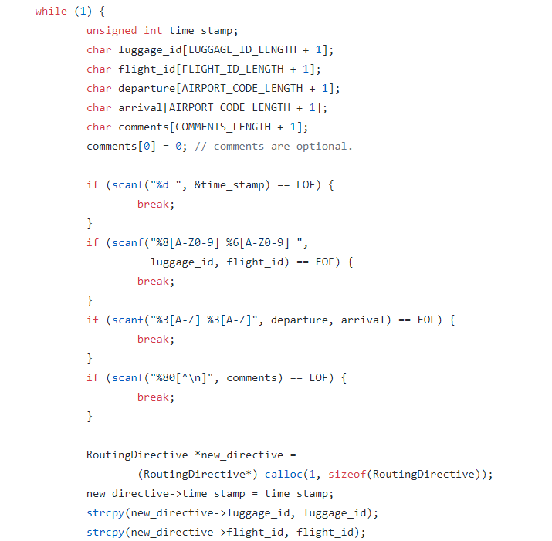

Slide 13
Flow
Flow is fundamental to understanding not just code, but how the various components interact
Control flow is the order in which individual statements, instructions of function calls are executed
Data flow is how data is advanced through the system
Consider interruptions to flow

Slide 14
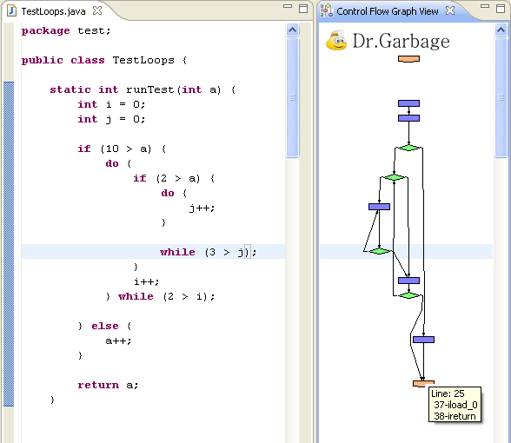
Code flow graph

Slide 15
Flow
Source
Sink
Other
The origin of the data as it enters the flow is the “source”
Usually we only care about sources that introduce untrusted or user supplied data
Identifying user controlled data is not always simple
The function that the data ends up in is the “sink”
The only sinks worth tracking is functions that must receive clean data
The source to sink flow may not direct or even intended to exist
Trust boundaries
State change

Slide 16
Taint analysis
#include <string.h>
void hello (char *n) {
char name[40];
strcpy(name, n);
}
int main (int argc, char **argv) {
hello(argv[1]);
return 0;
}

Slide 17
Approaches
Hot spot checking
Control flow sensitive
Data flow sensitive
Focus oriented
Forward tracing
Backwards tracing

Slide 18
Theory
Considerations
Limitations
Systems don’t exist in a vacuum
Race conditions
PHP configuration
Compiler optimizations can introduce vulnerabilities
Dynamic evaluation
Callbacks
Dynamic data operations

Slide 19
03
Vulnerabilities

Slide 20
Vulnerability
The existence of a weakness, design, or implementation error that can lead to an unexpected, undesirable event compromising the security of the computer system, network, application, or protocol involved.
-- ENISA

Slide 21
Vulnerability classifaction
OWASP Top10
Common Weakness Enumeration (CWE)
Other
While some are broad, it is only 10 categories of bugs
Semi-static
Based on commonality, not risk or impact
Silos
Top10 Web
Top10 Mobile
https://www.owasp.org/
Has classified 716 software weaknesses
Typically has a good definition with source code examples and description
https://cwe.mitre.org/
Web Application Security Consortium
Detailed advisories
White papers
Conference presentations

Slide 22
Identifying weaknesses
Read the documentation
Learn to recognize weakness patterns in source code
Learn to recognize weakness patterns in design/process
Anticipate poor decision making
Implement short test cases to verify behavior if unsure
Take breaks from complex/difficult code

Slide 23
Identified weakness
Check for exploitability
Check for dependencies
Authentication
Authorization
Configuration specific requirements
Assess the impact
Consider its use in a bug chain

Slide 24
04
Audit

Slide 25
Objectives
1
Identify weaknesses
2
Prioritize high impact vulnerabilities
3
Check exploitability

Slide 26
Tools
grep
Static source code analysis tools
https://github.com/mre/awesome-static-analysis
https://www.owasp.org/index.php/Source_Code_Analysis_Tools
Tools cannot find some types of vulnerabilities
Human analysis is required

Slide 27
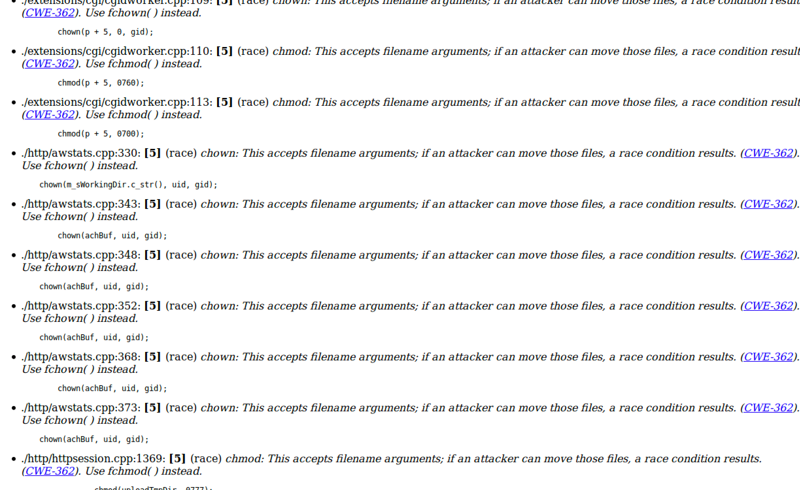

Slide 28
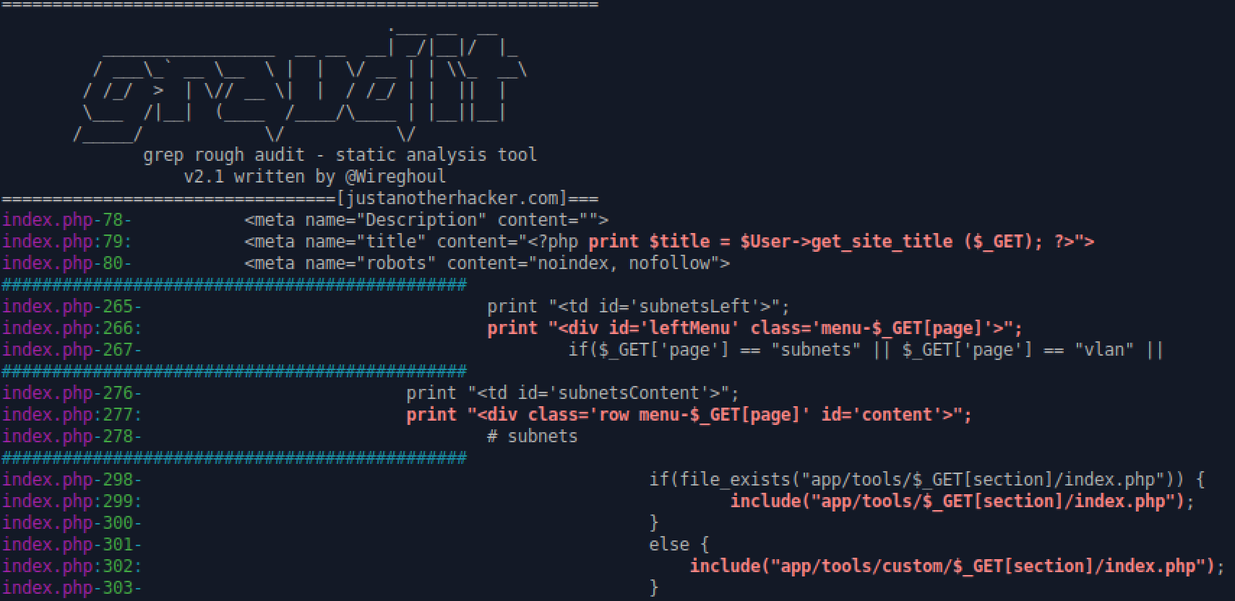

Slide 29
Auditing examples
Example: dns-control
Identify critical component and forward trace code to identify logic flaw
Leading to authentication bypass

Slide 30
Live audit

Slide 31
05
Workshop audit

Slide 32
Follow along
Git clone or download as zip the following repositories:
graudit
https://github.com/wireghoul/graudit (or google github graudit)
openemr
https://github.com/openemr/openemr (or google github openemr)
openlitespeed
https://github.com/litespeedtech/openlitespeed (or google github openlitespeed)
Notes:
Remember to dupe to intro so people can start downloading early..

Slide 33
Live audit

Slide 34
06
Conclusion

Slide 35
DevSecOps notes
Shifting source code/security audits left in your development life cycle avoids vulnerabilities in shipped software, keeping your users safe
Secure development doesn’t have to use expensive tools or be advanced to be highly effective. The following article implements taint analysis as a visual cue for developers, using a process that is language agnostic:
https://www.joelonsoftware.com/2005/05/11/making-wrong-code-look-wrong/
Train developers in security/secure development
Make sure some of your cyber security staff understands software development

Slide 36
Conclusion
Vulnerability discovery doesn’t have to be advanced
Some vulnerabilities can be very hard to identify
Source code review may not be the simplest approach
Finding the vulnerability is usually just the start of the journey

Slide 37
Questions?

